Slide 1
IsoDAR 60 MeV/amu Simulations Sensitivty Studies
Daniel Winklehner PSI/MIT Meeting, Sep 14th, 2020

Slide 2
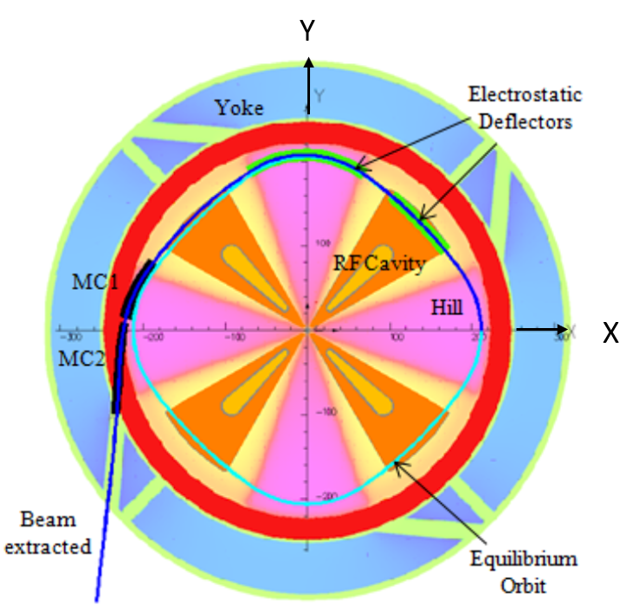
Cyclotron/OPAL Overview – harmonic 4
OPAL:
Track 1e5 particles
Single bunch
32^3 mesh – FFT solver (no boundaries)
42° cavity opening angle, f = 32.77 MHz
1000 steps per turn – 104 turns
Start with Gaussian matched distribution → 4 sigma truncation
Probe at 30°
Each cavity has 2 idealized 10 mm accelerating gaps with a radial profile V(r) from 70 kV-250kV
Magnetic field given on median plane only → OPAL calculates z ≠ 0 components from series expansion.

Slide 3
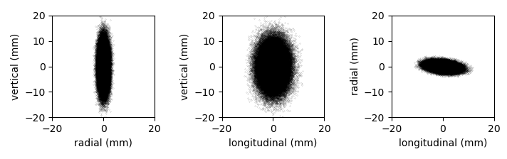
Initial beam parameters
Gaussian matched distribution at 193 keV/amu
Max. Height: ~3 cm, Length ~2.6 cm, Width ~0.8 cm
1-RMS, normalized emittance:
vertical: 0.6 mm-mrad
Radial: 0.14 mm-mrad

Slide 4
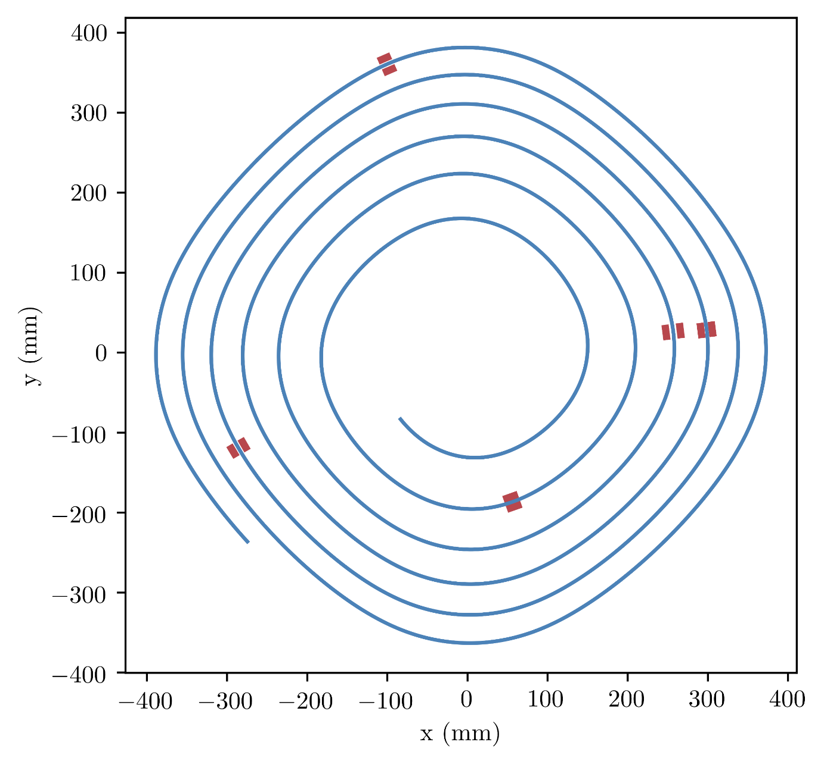
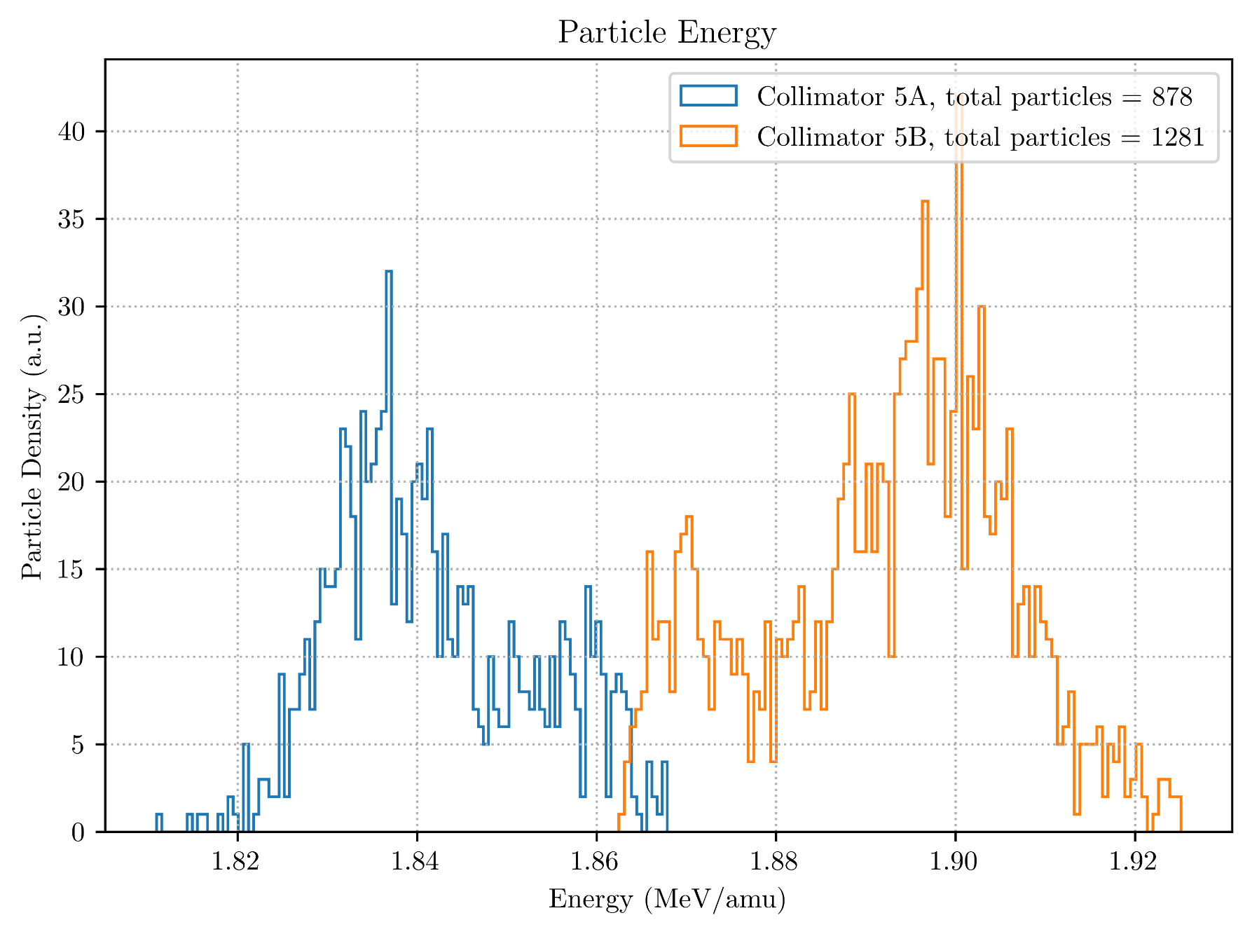
Collimators
Initial particle angle: -135°
5 Collimators
1e5 particles total

Slide 5
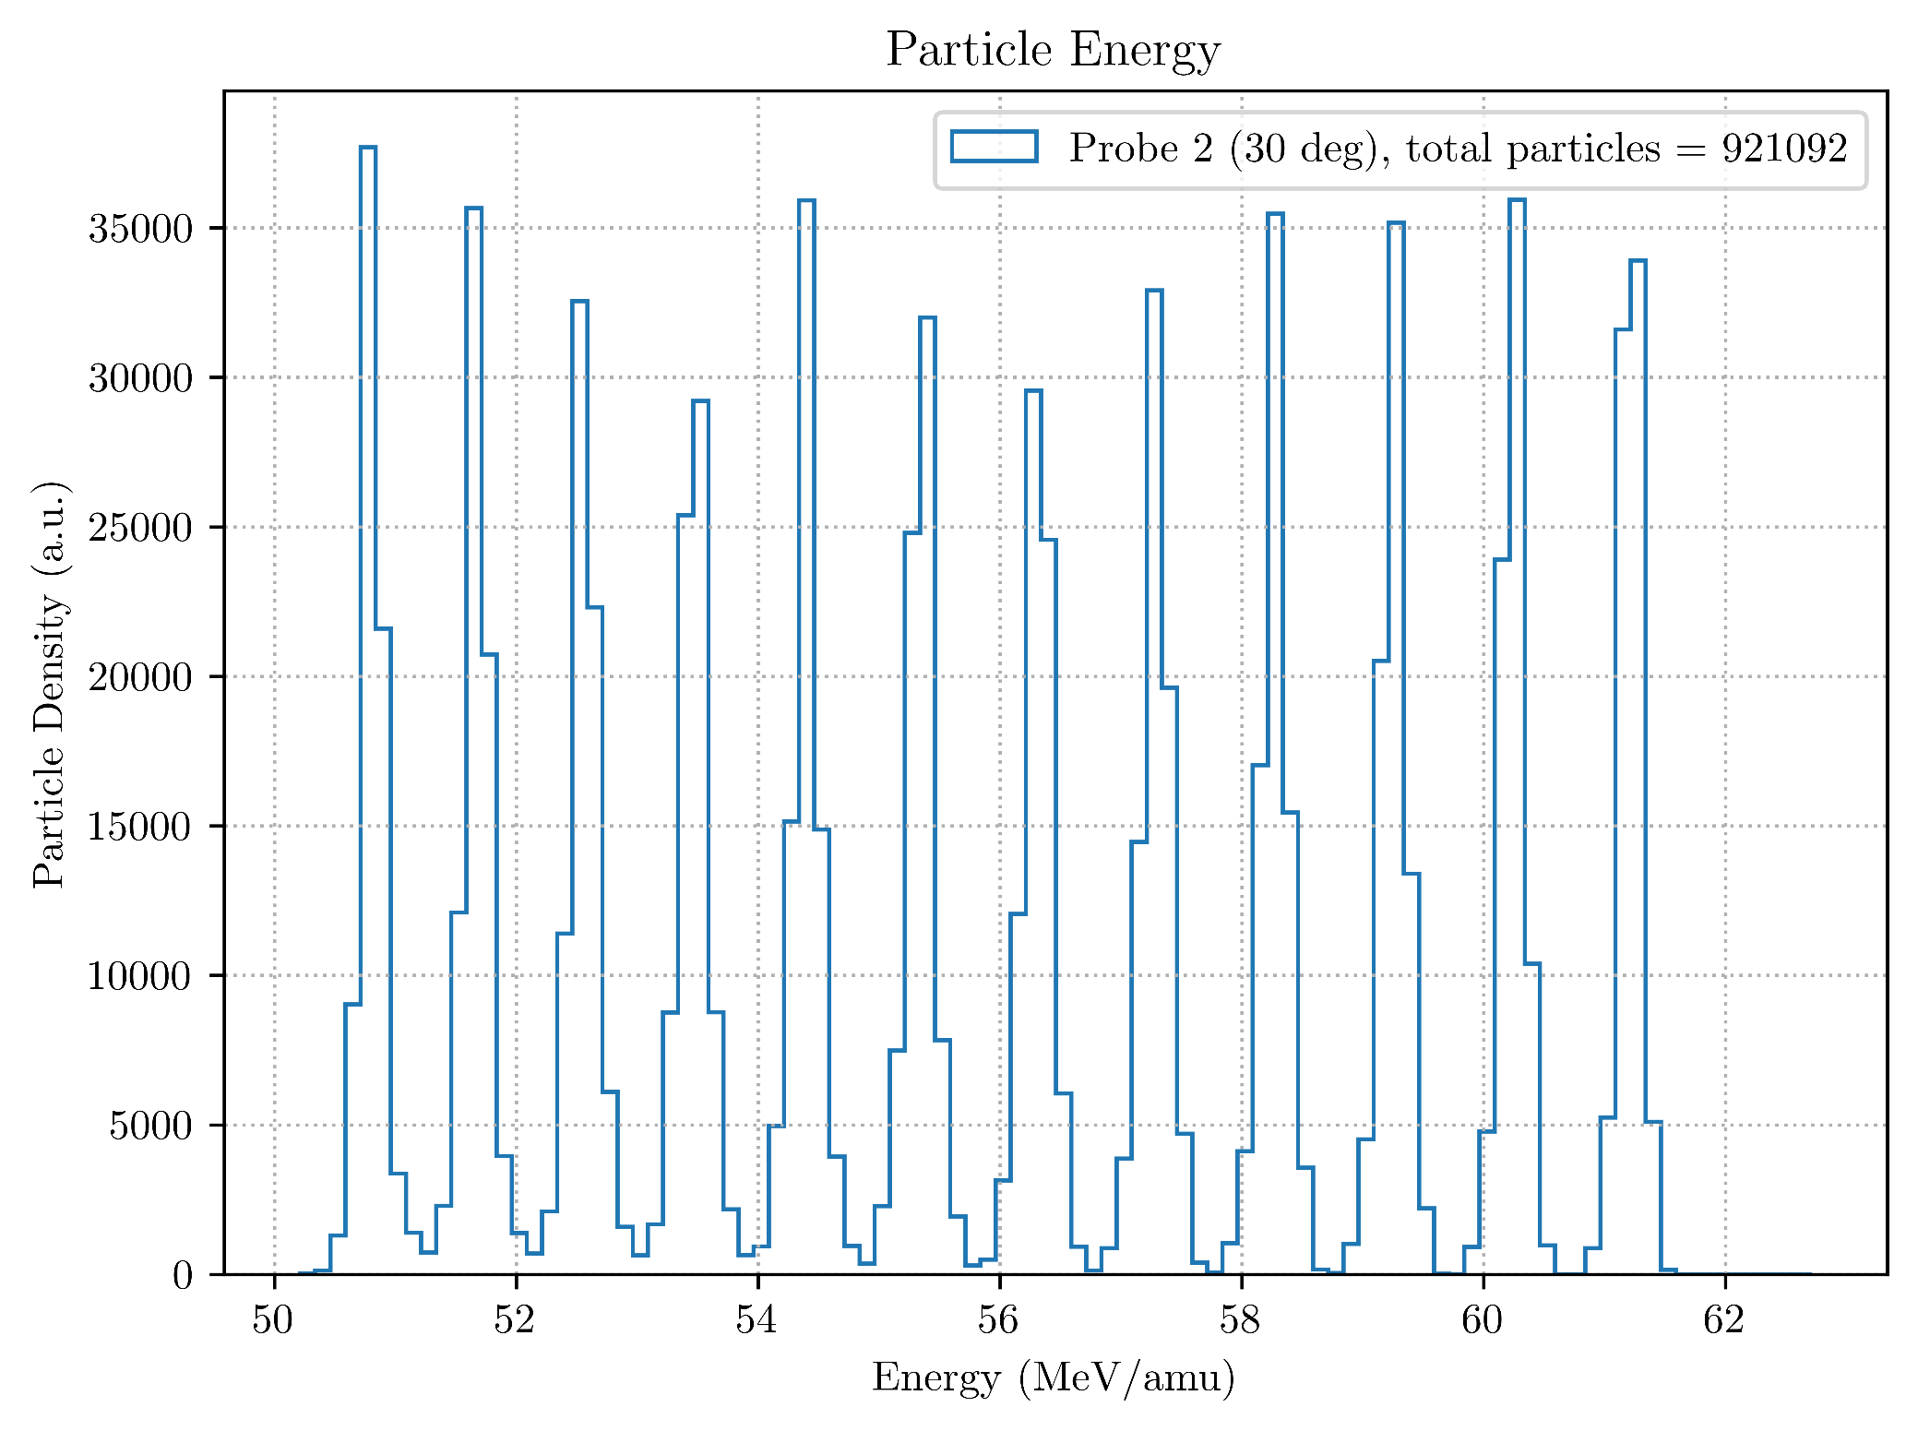
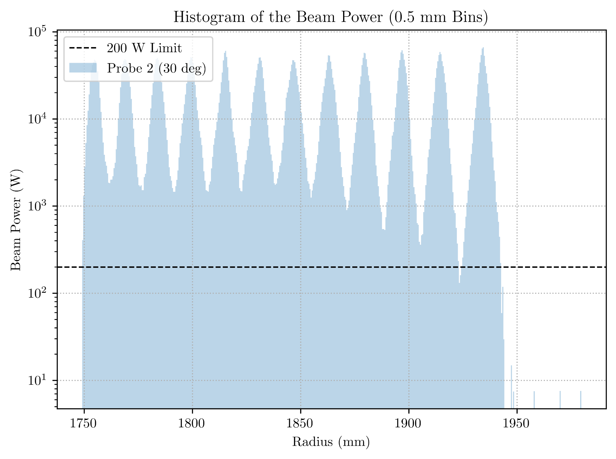
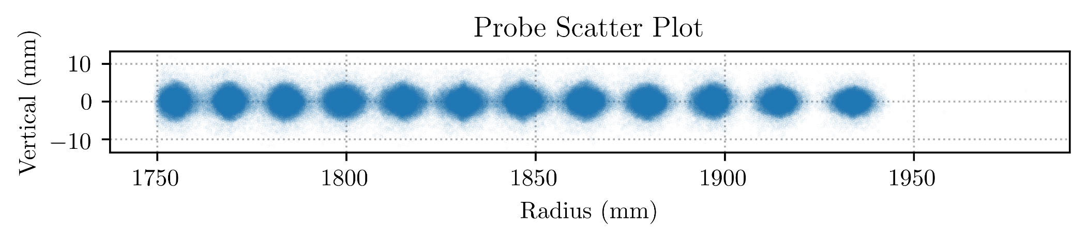
Probe 2 Data (30° from pos x-axis)
septum
23% Loss on collimators
132 W on septum

Slide 6
Procedure to add electrostatic deflectors (ESD)
Run OPAL up to 98 turns, saving particle data 2-4 times per turn
Re-run OPAL from 98 to 104 turns with high resolution
Use h5 output file to generate ESD1 → Inventor → COMSOL → OPAL
Re-run OPAL turn 98 to 104 with new fields and CCOLLIMATORs
Use new trajectory to generate ESD2
Do twice to make ESD’s follow new trajectory instead of original one

Slide 7
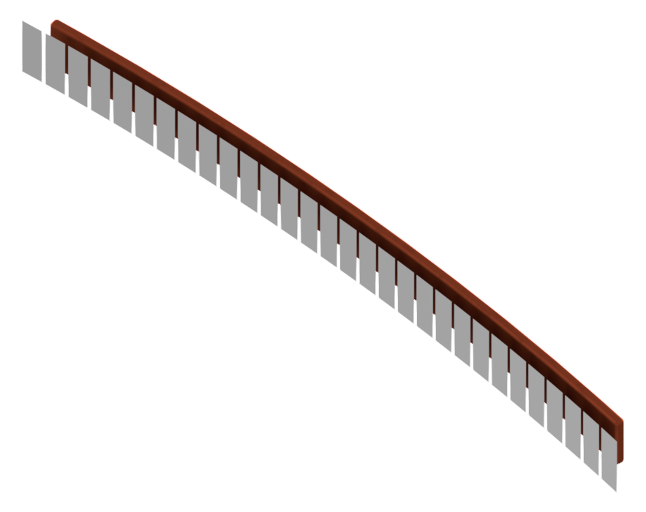
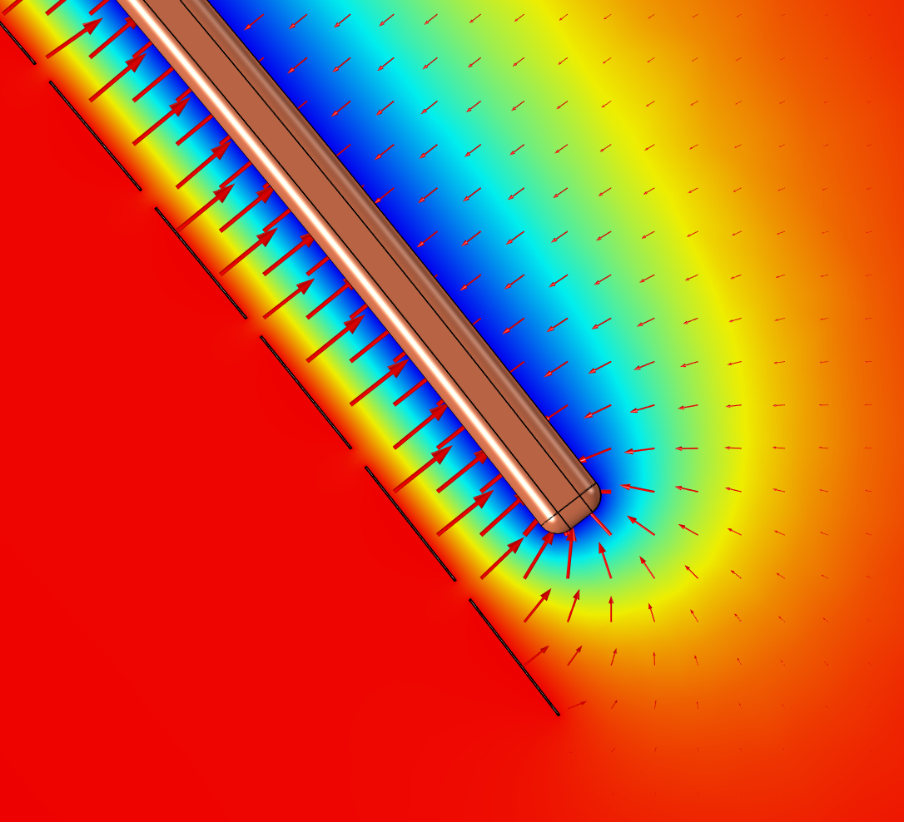
CAD → Electrostatic Field
Python Script → Inventor Macro → Model
Iges import → COMSOL → Field → OPAL h5part format

Slide 8
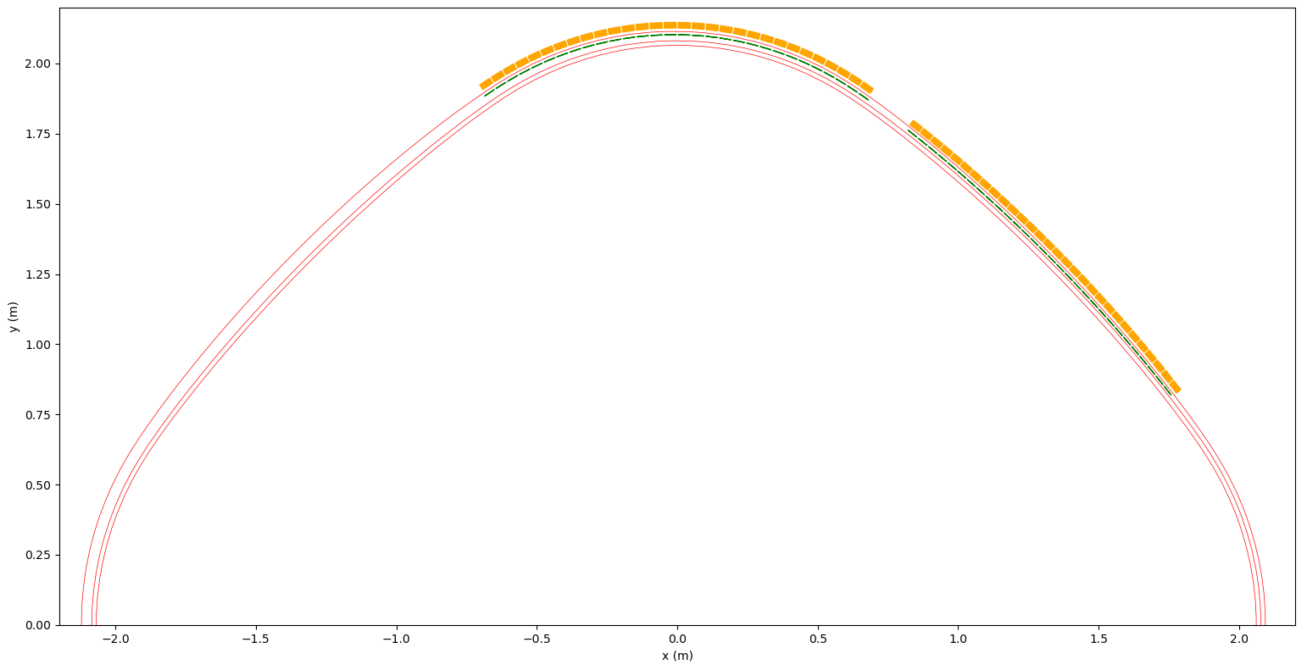
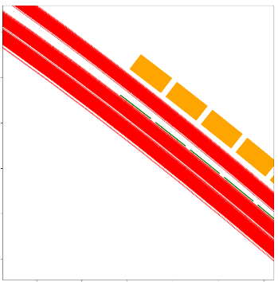
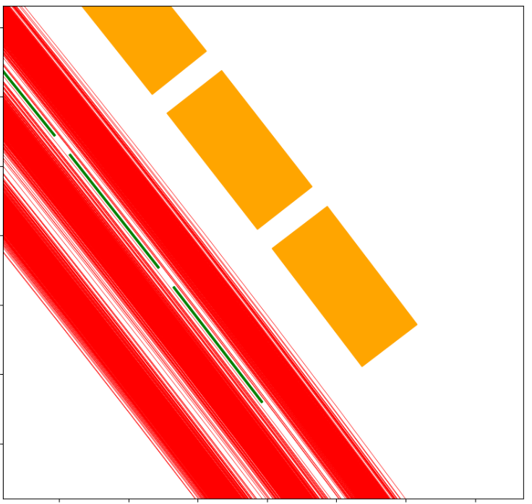
Preliminary Result
E

Slide 9
Sensitivity Study
This is getting us close to start-to-end…so, here is the plan:
Devin is working on refinement and analysis of output beam
Daniel is working on tracking beam through spiral inflector
Sonalie will begin a sensitivity study, varying the input beam parameters:
(Have begun already with current variation)
Beam radial position
Beam radial momentum component
Bunch phase
Beam size
r_{bunch}
p_{r}
p_{l}

Slide 10
Discussion: Data Exchange
Git repo for simulation decks and analysis python scripts: https://github.com/DanielWinklehner/isodar-60mev.git
Midplane magnetic field maps and voltage profile - OK
How to share the large 3D field maps and h5 output files?
Dropbox (limited to 2 TB with Pro account)
Fileserver
Combos (maybe this: https://github.com/anishathalye/git-remote-dropbox)
Maintain good workflow (we need to establish this)
Maintain good documentation

